Slide 1

Lets have
a deeper
understanding

Slide 2
Options markets

Slide 3
Options
An option is a derivative financial instrument that specifies a contract between two parties for a future transaction on an asset at a reference price.
The buyer of the option gains the right, but not the obligation, to engage in that transaction, while the seller incurs the corresponding obligation to fulfill the transaction.

Slide 4
Option Classifications
Call Option : an option which gives a right to buy the underlying asset at a strike price.
Put Option : an option which gives a right to sell the underlying asset at strike price.

Slide 5
Option Classifications
Underline assets can be:
Commodity
Agriculture
Metals
Precious metals
Base metal
Energy
Stock
Index
Interest rate
Currency

Slide 6
TYPE OF OPTIONS
American options: American options are options that can be exercised at any time upto the expiration date.
European options: European options are options that can be exercised only on the expiration date itself.

Slide 7
TYPE OF OPTIONS
European options
American options
Call option
PUT option
Call option
PUT
option

Slide 8
OPTION TERMINOLOGY
Index options: These options have the index as the underlying.
Stock options: Stock options are options on individual stocks.
Buyer of an option: The buyer of an option is the one who by paying the option premium buys the right but not the obligation to exercise his option on the seller/writer.

Slide 9
OPTION TERMINOLOGY
Writer of an option: The writer of a call/put option is the one who receives the option premium and is thereby obliged to sell/buy the asset if the buyer exercises on him.
Option price/premium: Option price is the price which the option buyer pays to the option seller.
Expiration date: The date specified in the options contract is known as the expiration date, the exercise date, the strike date or the maturity.

Slide 10
OPTION TERMINOLOGY
Strike price: The price specified in the options contract is known as the strike price or the exercise price.
In-the-money option: An in-the-money (ITM) option is an option that would lead to a positive cash flow to the holder if it were exercised immediately. (i.e. spot price > strike price(for call option) and opposite in case of put option)
At-the-money option: An at-the-money (ATM) option is an option that would lead to zero cash flow if it were exercised immediately.(i.e. spot price = strike price)(both case).

Slide 11
OPTION TERMINOLOGY
Out-of-the-money option: An out-of-the-money (OTM) option is an option that would lead to also zero cash flow if it were exercised immediately.(i.e. spot price < strike price)(for call option) and opposite in case of put option).
Intrinsic value of an option: The option premium can be broken down into two components
Intrinsic value
Time value.
The intrinsic value of a call is the amount the option is ITM, if it is ITM. If the call is OTM, its intrinsic value is zero.
Time value of an option: The time value of an option is the difference between its premium and its intrinsic value.

Slide 12
Call Option
Buyer of a call option: The buyer of a call option is the one who by paying the option premium buys the right to buy but not the obligation to buy that particularly underline assets.
Writer/seller of a call option: The writer/sell of a call option is the one who receives the option premium and is thereby obliged to sell the underline asset if the buyer exercises on him.

Slide 13
Put Option
Buyer of a put option: The buyer of a put option is the one who by paying the option premium buys the right to sell but not the obligation to sell that particularly underline assets.
Writer/seller of a put option: The writer/seller of a put option is the one who receives the option premium and is thereby obliged to buy the underline asset if the buyer exercises on him.

Slide 14
Example.
A European call option of nifty at a strike price of Rs.7500 is selling at a premium of Rs.110 (current price of nifty is 7600)will expire on 28th October 2015.
It is a…
European call option
Index options(nifty)
Strike price is 7500.
Spot price is 7600
Expiration date is 28th October 2015.

Slide 15
Example.
Option is ITM OR ATM OR OTM……..it is ITM because spot price > strike price.
Intrinsic value and Time value.
Intrinsic value = 7600 – 7500 = 100
Time value is 110 – 100 = 10

Slide 16


Slide 17


Slide 18
Exercise For Call
Spot Price 1000
Strike Price 1200
Que: “ITM” or “OTM” or “ATM”

Slide 19
Exercise For Call
OTM

Slide 20
Exercise For Call
Spot Price 2999
Strike Price 3999
Que: “ITM” or “OTM” or “ATM”

Slide 21
Exercise For Call
OTM

Slide 22
Exercise For Call
Spot Price 4123
Strike Price 3321
Que: “ITM” or “OTM” or “ATM”

Slide 23
Exercise For Call
ITM

Slide 24
Exercise For Call
Spot Price 2123
Strike Price 3321
Que: “ITM” or “OTM” or “ATM”

Slide 25
Exercise For Call
OTM

Slide 26
Exercise For Call
Spot Price 15123
Strike Price 13321
Que: “ITM” or “OTM” or “ATM”

Slide 27
Exercise For Call
ITM

Slide 28
Exercise For Call
Spot Price 123
Strike Price 321
Que: “ITM” or “OTM” or “ATM”

Slide 29
Exercise For Call
OTM

Slide 30
Exercise For Call
Spot Price 1223
Strike Price 1222
Que: “ITM” or “OTM” or “ATM”

Slide 31
Exercise For Call
ITM

Slide 32
Exercise For Call
Spot Price 1221
Strike Price 1222
Que: “ITM” or “OTM” or “ATM”

Slide 33
Exercise For Call
0TM

Slide 34
Exercise For Call
Spot Price 1000
Strike Price 1000
Que: “ITM” or “OTM” or “ATM”

Slide 35
Exercise For Call
ATM

Slide 36
Exercise For Put
Spot Price 1000
Strike Price 1200
Que: “ITM” or “OTM” or “ATM”

Slide 37
Exercise For Put
ITM

Slide 38
Exercise For Put
Spot Price 2999
Strike Price 3999
Que: “ITM” or “OTM” or “ATM”

Slide 39
Exercise For Put
ITM

Slide 40
Exercise For Put
Spot Price 4123
Strike Price 3321
Que: “ITM” or “OTM” or “ATM”

Slide 41
Exercise For Put
OTM

Slide 42
Exercise For Put
Spot Price 2123
Strike Price 3321
Que: “ITM” or “OTM” or “ATM”

Slide 43
Exercise For Put
ITM

Slide 44
Exercise For Put
Spot Price 15123
Strike Price 13321
Que: “ITM” or “OTM” or “ATM”

Slide 45
Exercise For Put
OTM

Slide 46
Exercise For Put
Spot Price 123
Strike Price 321
Que: “ITM” or “OTM” or “ATM”

Slide 47
Exercise For Call
ITM

Slide 48
Exercise For Put
Spot Price 1223
Strike Price 1222
Que: “ITM” or “OTM” or “ATM”

Slide 49
Exercise For Put
OTM

Slide 50
Exercise For Call
Spot Price 1223
Strike Price 1224
Que: “ITM” or “OTM” or “ATM”

Slide 51
Exercise For Call
ITM

Slide 52
Exercise For Call
Spot Price 1224
Strike Price 1224
Que: “ITM” or “OTM” or “ATM”

Slide 53
Exercise For Call
ATM

Slide 54
Now, we get some sense out of the story!!!!!!!!!!!!!!!!

Slide 55
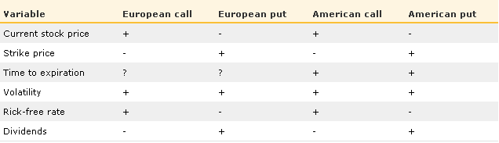
Factors that influence put and call prices

Slide 56
Current stock price for call
Call option premium = (S – K) + x
Please note that if (S-K) is negative then we will take value zero.
Example = (110 – 100) + x =10+x
Spot price 110 120 then, OP 20+x
Spot price
Strike price
Option premium
Positive relation

Slide 57
Current stock price for call
Call option premium = (S – K) + x
Please note that if (S-K) is negative then we will take value zero.
Example = (110 – 100) + x =10+x
Spot price 110 105 then, OP 5+x
Spot price
Strike price
Option premium
Positive relation

Slide 58
Current stock price for Put
Put option premium = (K – S) + x
Please note that if (K-S) is negative then we will take value zero.
Example = (110 – 100) + x =10+x
Spot price 100 105 then, OP to 5+x
Strike price
Spot price
Option premium
Negative relation

Slide 59
Current stock price for Put
Put option premium = (K – S) + x
Please note that if (K-S) is negative then we will take value zero.
Example = (110 – 100) + x =10+x
Spot price 100 90 then, OP to 20+x
Strike price
Spot price
Option premium
Negative relation

Slide 60
Current strike price for call
Call option premium = (S – K) + x
Please note that if (S-K) is negative then we will take value zero.
Example = (110 – 100) + x =10+x
Strike price 100 105 then, OP 5+x
Spot price
Strike price
Option premium
Negative relation

Slide 61
Current strike price for call
Call option premium = (S – K) + x
Please note that if (S-K) is negative then we will take value zero.
Example = (110 – 100) + x =10+x
Strike price 100 90 then, OP 20+x
Spot price
Strike price
Option premium
Negative relation

Slide 62
Current Strike price for Put
Put option premium = (K – S) + x
Please note that if (K-S) is negative then we will take value zero.
Example = (110 – 100) + x =10+x
Strike price 110 115 then, OP to 15+x
Strike price
Spot price
Option premium
Positive relation

Slide 63
Current Strike price for Put
Put option premium = (K – S) + x
Please note that if (K-S) is negative then we will take value zero.
Example = (110 – 100) + x =10+x
Strike price 110 105 then, OP to 5+x
Strike price
Spot price
Option premium
Positive relation

Slide 64
Dividend for Call
Call option premium = (S – K) + x
Please note that if (S-K) is negative then we will take value zero.
Example = (110 – 100) + x =10+x
We also know that current expiry is 31 October, there is one additional information, on 25 Oct company will pay dividend of rupee 20
DIVIDEND 0 TO 20 then, SP , OP
Spot price
Strike price
Option premium
Negative relation

Slide 65
Dividend for Put
Put option premium = (K – S) + x
Please note that if (K-S) is negative then we will take value zero.
Example = (110 – 100) + x =10+x
We also know that current expiry is 31 October, there is one additional information on 25 Oct company will pay dividend of rupee 20
Dividend 0 20 then, SP OP
Strike price
Spot price
Option premium
Positive relation

Slide 66
Time to expiry for Call without additional information
Call option premium = (S – K) + x
Please note that if (S-K) is negative then we will take value zero.
Example = (110 – 100) + x =10+x
We also know that current expiry is 31 October, there is one additional information on 15 Nov company will pay dividend of rupee 20
Expiry 31 October 30 Nov then we have more time to book profit means x part will increase so OP
Spot price
Strike price
Option premium
Positive relation

Slide 67
Time to expiry for Call with additional information
Call option premium = (S – K) + x
Please note that if (S-K) is negative then we will take value zero.
Example = (110 – 100) + x =10+x
We also know that current expiry is 31 October, there is one additional information on 15 Nov company will pay dividend of rupee 20
Expiry 31 October 30 Nov then, SP , OP
Spot price
Strike price
Option premium
Negative relation

Slide 68
Conclusion
On the basis of last two example we can not generalized our statement, answer will be Cant say

Slide 69
Dividend for Put without additional information
Put option premium = (K – S) + x
Please note that if (K-S) is negative then we will take value zero.
Example = (110 – 100) + x =10+x
We also know that current expiry is 31 October, there is one additional information on 15 Nov company will pay dividend of rupee 20
Expiry 31 October 30 Nov then, then we have more time to book profit means x part will increase so OP
Strike price
Spot price
Option premium
Positive relation

Slide 70
Dividend for Put without additional information
Put option premium = (K – S) + x
Please note that if (K-S) is negative then we will take value zero.
Example = (110 – 100) + x =10+x
There is one additional information available company business is seasonal and season starts in Nov
Expiry 31 October 30 Nov then, SP OP
Strike price
Spot price
Option premium
Negative relation

Slide 71
Conclusion
On the basis of last two example we can not generalized our statement, answer will be Cant say

Slide 72
Volatility for call
Call option premium = (S – K) + x
Please note that if (S-K) is negative then we will take value zero.
Example = (110 – 100) + x =10+x
Volatility Risk , we know that positive relation in risk and return, So return Should increase means option price
Spot price
Strike price
Option premium
Positive relation

Slide 73
Volatility for call
Call option premium = (S – K) + x
Please note that if (S-K) is negative then we will take value zero.
Example = (110 – 100) + x =10+x
Volatility Risk , we know that positive relation in risk and return, So return Should increase means option price
Spot price
Strike price
Option premium
Positive relation

Slide 74
Volatility for Put
Call option premium = (K – S) + x
Please note that if (K-S) is negative then we will take value zero.
Example = (110 – 100) + x =10+x
Volatility Risk , we know that positive relation in risk and return, So return Should increase means option price
Strike price
Spot price
Option premium
Positive relation

Slide 75
Volatility for Put
Call option premium = (K – S) + x
Please note that if (K-S) is negative then we will take value zero.
Example = (110 – 100) + x =10+x
Volatility Risk , we know that positive relation in risk and return, So return Should increase means option price
Strike price
Spot price
Option premium
Positive relation

Slide 76
Factors that influence put and call prices
Strike price = Strike price influence the call and put price. Higher the strike price lower the call option premium and higher the put option premium
Spot price = At a Given strike price higher the spot price higher the call option premium and lower the put premium.
Time to expiration = Relationship is uncertain with Time to expiration for call and put both.
Volatility = There is positive relationship with volatility higher the volatility higher the call and put premium.
Risk free rate = Higher the risk free rate higher the call option premium and lower the put option premium
Dividend = higher dividend lower call option premium and higher put option premium.

Slide 77
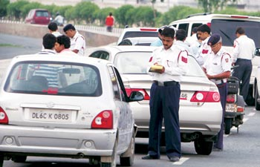
We discussed in the previous classes Forwards and Futures, Options and related terminology now Pay off

Slide 78
Any Question before we go ahead?
Let’s move to the payoff from options .

Slide 79
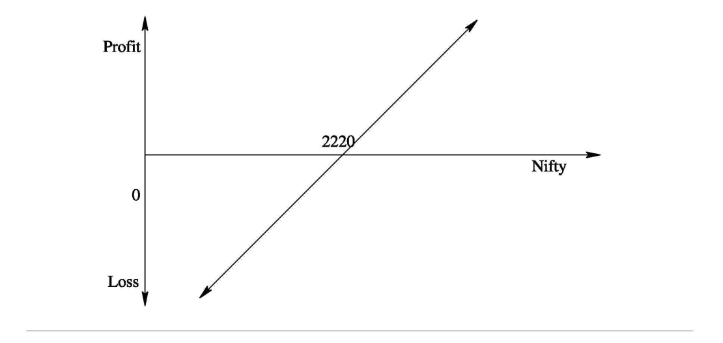
Lets first understand Payoff for buyer of futures: Long futures
The figure shows the profits/losses for a long futures position. The investor bought futures when the index was at 2220. If the index goes up, his futures position starts making profit. If the index falls, his futures position starts showing losses.

Slide 80
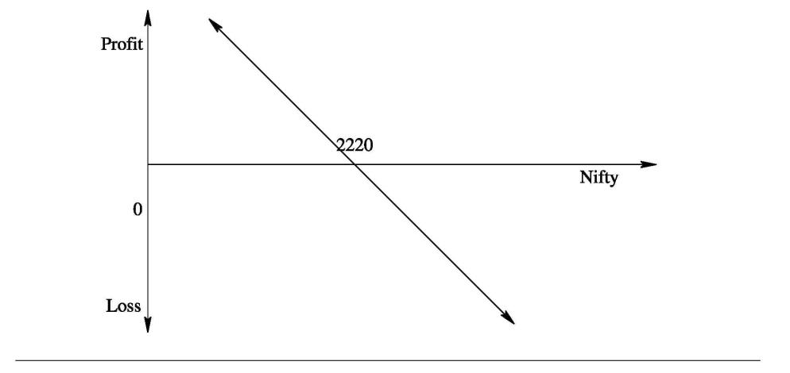
Payoff for seller of futures: Long futures
The figure shows the profits/losses for a short futures position. The investor sold futures when the index was at 2220. If the index goes down, his futures position starts making profit. If the index rises, his futures position starts showing losses

Slide 81


Is there any difference in fay off from futures and options

Slide 82
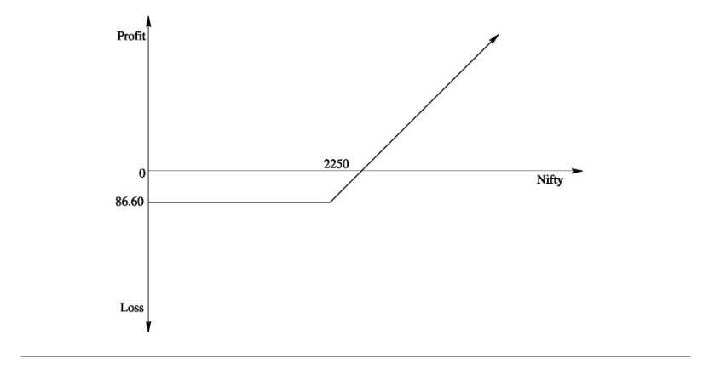
OPTIONS PAYOFFS Payoff for buyer of call option
The figure shows the profits/losses for the Nifty 2250 call option. The spot Nifty rises, the call option is in-the-money buyer would exercise his option and earn profit. The profits can be unlimited. However if Nifty falls below the strike of 2250 his losses are limited to the extent of the premium he paid for buying the option.

Slide 83
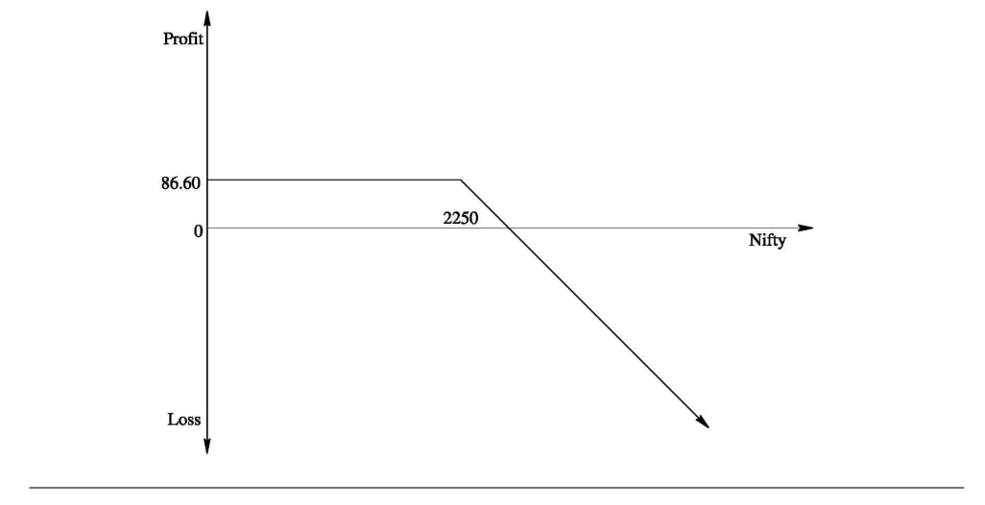
OPTIONS PAYOFFS Payoff for writer/seller of call option
The figure shows the profits/losses for the seller of a 2250 call option. As the spot Nifty rises, the call option is ITM and the writer/seller starts making losses to the extent of the difference between the Nifty -close and the strike price. The loss can be unlimited, whereas the maximum profit is limited to the extent of the up-front option premium of Rs.86.60 charged by him.

Slide 84
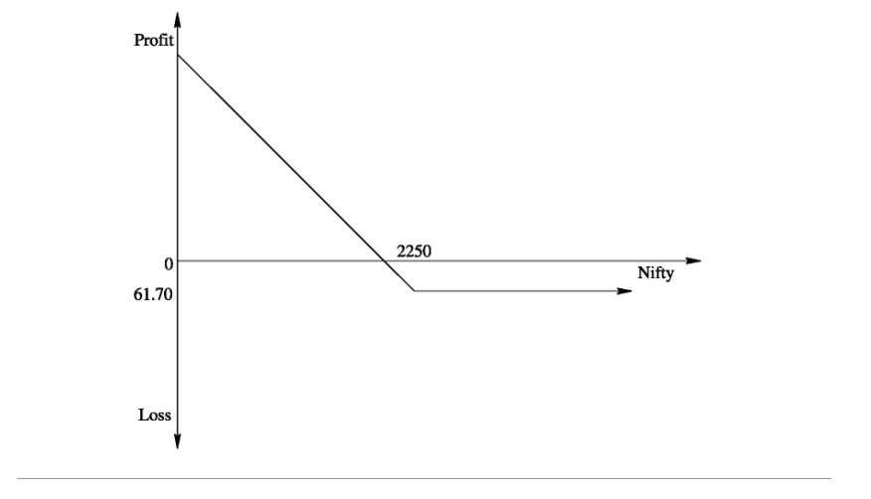
OPTIONS PAYOFFS Payoff for buyer of put option
The figure shows the profits/losses for the buyer of Nifty 2250 put option. As the spot Nifty falls, the put option is ITM the buyer would exercise his option and profit to the extent of the difference between the strike price and Nifty-close. However if Nifty rises above the strike of 2250, he lets the option expire. His losses are limited to the extent of the premium he paid for buying the option.

Slide 85
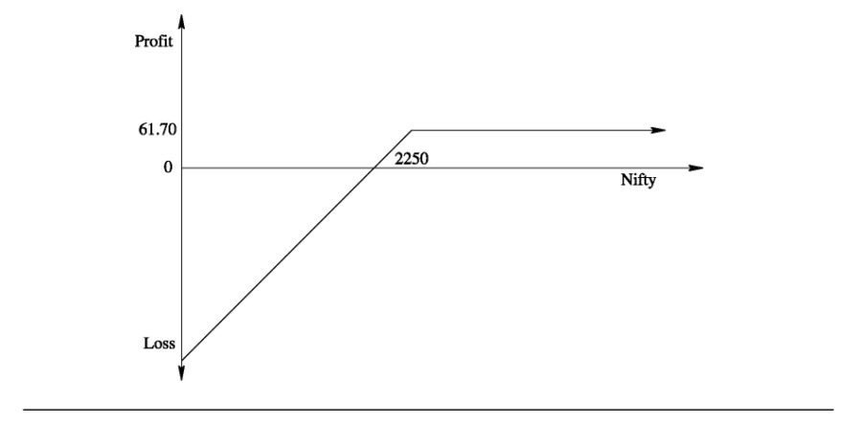
OPTIONS PAYOFFS Payoff for writer/seller of put option
The figure shows the profits/losses for the seller of Nifty 2250 put option. As the spot Nifty falls, the put option is ITM and the writer starts making losses to the extent of the difference between the strike price and Nifty-close. The loss that can be incurred by the writer of the option is a maximum extent of the strike price (Since the worst that can happen is that the asset price can fall to zero) whereas the maximum profit is limited premium of Rs.61.70 charged by him.

Slide 86
What next…?

Slide 87


Examples

Slide 88
Spot value of Nifty is 2157. An investor buys a one month nifty 2140 call option for a premium of Rs.27. The option is?
Strike price?
ATM,ITM,OTM?
Intrinsic value?
Time value?
If nifty close at 2300 P/L of buyer and seller of option.
If nifty close at 2000 P/L of buyer and seller of option.

Slide 89
Spot value of Nifty is 2157. An investor buys a one month nifty 2140 call option for a premium of Rs.27. The option is?
Strike price
2140

Slide 90
Spot value of Nifty is 2157. An investor buys a one month nifty 2140 call option for a premium of Rs.27. The option is?
ATM,ITM,OTM?
ITM
Because
Spot price > strike price

Slide 91
Spot value of Nifty is 2157. An investor buys a one month nifty 2140 call option for a premium of Rs.27. The option is?
Intrinsic value?
Time value?
Intrinsic value = 2157 – 2140 = 17
Time value = 27-17 = 10

Slide 92
Spot value of Nifty is 2157. An investor buys a one month nifty 2140 call option for a premium of Rs.27. The option is?
If nifty close at 2300 P/L of buyer and seller of option.
Buyer of option
Gross profit = (2300 – 2140,0)* = 160
Net profit = 160 – 27 = 133
* If closing price is > strike then difference otherwise 0
seller of option
Gross loss = (2300 – 2140,0)* = (160)
Net loss = (160) + 27 = (133)
* If closing price is > strike then difference otherwise 0

Slide 93
Spot value of Nifty is 2157. An investor buys a one month nifty 2140 call option for a premium of Rs.27. The option is?
If nifty close at 2000 P/L of buyer and seller of option.
Buyer of option
Gross loss = (2000 – 2140, 0)* = 0
Net loss = – 27 = (27)
* If closing price is > strike then difference otherwise 0
Seller of option
Gross profit = (2000 – 2140, 0)* = 0
Net profit = 27 = 27
* If closing price is > strike then difference otherwise 0

Slide 94


Slide 96
Spot value of Nifty is 7500. An investor buys a one month nifty 7000 call option for a premium of Rs.527.
If nifty close at 8000 P/L of buyer and seller of option.
Buyer of option
Gross profit = (8000 – 7000,0)* = 1000
Net profit = 1000 – 527 = 473
Seller of option
Gross loss = (8000 – 7000,0)* = (1000)
Net loss = (1000) + 527 = (473)

Slide 97
Spot value of Nifty is 7500. An investor buys a one month nifty 7000 call option for a premium of Rs.527.
If nifty close at 8000 P/L of buyer and seller of option.
Buyer of option
Gross profit = (8000 – 7000,0)* = 1000
Net profit = 1000 – 527 = 473
Seller of option
Gross loss = (8000 – 7000,0)* = (1000)
Net loss = (1000) + 527 = (473)

Slide 98
Spot value of Nifty is 7500. An investor buys a one month nifty 7000 call option for a premium of Rs.527.
If nifty close at 8000 P/L of buyer and seller of option.
Buyer of option
Gross profit = (8000 – 7000,0)* = 1000
Net profit = 1000 – 527 = 473
Seller of option
Gross loss = (8000 – 7000,0)* = (1000)
Net loss = (1000) + 527 = (473)

Slide 99
Spot value of Nifty is 7500. An investor buys a one month nifty 7000 call option for a premium of Rs.527.
If nifty close at 8000 P/L of buyer and seller of option.
Buyer of option
Gross profit = (8000 – 7000,0)* = 1000
Net profit = 1000 – 527 = 473
Seller of option
Gross loss = (8000 – 7000,0)* = (1000)
Net loss = (1000) + 527 = (473)

Slide 100
Spot value of Nifty is 7500. An investor buys a one month nifty 7000 call option for a premium of Rs.527.
If nifty close at 8000 P/L of buyer and seller of option.
Buyer of option
Gross profit = (8000 – 7000,0)* = 1000
Net profit = 1000 – 527 = 473
Seller of option
Gross loss = (8000 – 7000,0)* = (1000)
Net loss = (1000) + 527 = (473)

Slide 101
Spot value of Nifty is 10000. An investor buys a one month nifty 10500 call option for a premium of Rs.27.
If nifty close at 11000 P/L of buyer and seller of option.
Buyer of option
Gross profit = (11000 – 10500, 0) = 500
Net profit = 500 – 27 = 473
Seller of option
Gross loss = (11000 – 10500,0)* = (500)
Net loss = (500) + 27 = (473)

Slide 102
Spot value of Nifty is 10000. An investor buys a one month nifty 10500 call option for a premium of Rs.27.
If nifty close at 11000 P/L of buyer and seller of option.
Buyer of option
Gross profit = (11000 – 10500, 0) = 500
Net profit = 500 – 27 = 473
Seller of option
Gross loss = (11000 – 10500,0)* = (500)
Net loss = (500) + 27 = (473)

Slide 103
Spot value of Nifty is 10000. An investor buys a one month nifty 10500 call option for a premium of Rs.27.
If nifty close at 11000 P/L of buyer and seller of option.
Buyer of option
Gross profit = (11000 – 10500, 0) = 500
Net profit = 500 – 27 = 473
Seller of option
Gross loss = (11000 – 10500,0)* = (500)
Net loss = (500) + 27 = (473)

Slide 104
Spot value of Nifty is 10000. An investor buys a one month nifty 10500 call option for a premium of Rs.27.
If nifty close at 11000 P/L of buyer and seller of option.
Buyer of option
Gross profit = (11000 – 10500, 0) = 500
Net profit = 500 – 27 = 473
Seller of option
Gross loss = (11000 – 10500,0)* = (500)
Net loss = (500) + 27 = (473)

Slide 105
Spot value of Nifty is 10000. An investor buys a one month nifty 10500 call option for a premium of Rs.27.
If nifty close at 11000 P/L of buyer and seller of option.
Buyer of option
Gross profit = (11000 – 10500, 0) = 500
Net profit = 500 – 27 = 473
Seller of option
Gross loss = (11000 – 10500,0)* = (500)
Net loss = (500) + 27 = (473)

Slide 106
Spot value of Nifty is 10000. An investor buys a one month nifty 10500 call option for a premium of Rs.27.
If nifty close at 9500 P/L of buyer and seller of option.
Buyer of option
Gross profit = (11000 – 10500, 0) = 500
Net profit = 500 – 27 = 473
Seller of option
Gross loss = (11000 – 10500,0)* = (500)
Net loss = (500) + 27 = (473)

Slide 107
Spot value of Nifty is 10000. An investor buys a one month nifty 10500 call option for a premium of Rs.27.
If nifty close at 9500 P/L of buyer and seller of option.
Buyer of option
Gross profit = (11000 – 10500, 0) = 500
Net profit = 500 – 27 = 473
Seller of option
Gross loss = (11000 – 10500,0)* = (500)
Net loss = (500) + 27 = (473)

Slide 108
Spot value of Nifty is 10000. An investor buys a one month nifty 10500 call option for a premium of Rs.27.
If nifty close at 9500 P/L of buyer and seller of option.
Buyer of option
Gross profit = (9500 – 10500, 0) = 0
Net profit = 0 – 27 = -27
Seller of option
Gross loss = (11000 – 10500,0)* = (500)
Net loss = (500) + 27 = (473)

Slide 109
Spot value of Nifty is 10000. An investor buys a one month nifty 10500 call option for a premium of Rs.27.
If nifty close at 9500 P/L of buyer and seller of option.
Buyer of option
Gross profit = (11000 – 10500, 0) = 500
Net profit = 500 – 27 = 473
Seller of option
Gross loss = (11000 – 10500,0)* = (500)
Net loss = (500) + 27 = (473)

Slide 110
Spot value of Nifty is 10000. An investor buys a one month nifty 10500 call option for a premium of Rs.27.
If nifty close at 9500 P/L of buyer and seller of option.
Buyer of option
Gross profit = (11000 – 10500, 0) = 500
Net profit = 500 – 27 = 473
Seller of option
Gross loss = (9500 – 10500,0)* = (0)
Net loss = (0) + 27 = 27

Slide 111
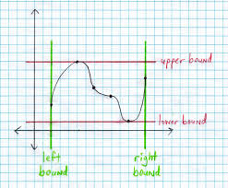

Slide 112
UPPER AND LOWER BOUNDS.

Slide 113
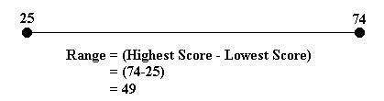
UPPER AND LOWER BOUNDS FOR OPTION PRICES
If an option price is above the upper bound or below the lower bound, then there are profitable opportunities for arbitrageurs.

Slide 114
UPPER AND LOWER BOUNDS FOR OPTION PRICES
We assume following statements:
1. There are no transactions costs.
2. All trading profits (net of trading losses) are subject to the same tax rate.
3. Borrowing and lending are possible at the risk-free interest rate which is also fixed.

Slide 115
Upper Bound call
No matter what happens, the option premium can never be worth more than the stock.
c ≤ S₀ and C ≤ S₀
c Value of European call option to buy one share
C Value of American call option to buy one share
S₀ Current stock price

Slide 116
Upper Bound call
If these relationships were not true, an arbitrageur could easily make a riskless profit by buying the stock and selling the call option.

Slide 117
Upper Bound call
c ≤ S₀ and C ≤ S₀
For any reason if,
c ≥ S₀ and C ≥ S₀
Lets assume a scenario, for call option
S = 10, K = 5, Option Premium = 12
Sell option @ 12, buy asset @10 and save 2 rupee, on expiry if buyer will opt right to buy than take rupee 5 and transfer asset. Total profit is 7 rupee.
So we can say this is “c ≤ S₀ and C ≤ S₀” true

Slide 118
Upper Bound Put
An American put option gives the holder the right to sell
No matter how low the stock price becomes, the option premium can never be worth more than K. Hence
P ≤ K
Example: No one will pay 26000 to buy right to sell@25000, so we can say in any condition premium for put option will be less than 25000 for strike price 25000

Slide 119
Upper Bounds
For European options, we know that at maturity the option cannot be worth more than K. P ≤ K (only at maturity)
It cannot be worth more than the present value of K today:
p ≤ Ke^{-rT}
p: Value of European put option to sell one share
K : Strike price of option
T: Time to expiration of option
r: Continuously compounded risk-free rate of interest for an investment maturing t in time T

Slide 120
Upper Bounds
p ≤ Ke^{-rT}
As we know that above equation, lets take 1 example
Put option premium = 24500
K = 25000
R = 10%
T = 2 year
Can a arbitrager earn profit?????

Slide 121
Upper Bounds
Yes
Sell put option premium @ 24500, invest 24500 for 2 year
After 2 year value will be 29924.37
Possibility cases
Price of asset = 20000 (means less than 25000)
Price of asset = 25000 (means same as 25000)
Price of asset = 30000 (means more than 25000)

Slide 122
Upper Bounds
Possibility cases 1) price = 20000
Option buyer exercise right to sell @ 25000
In this deal profit will be 4924.37 plus realized value of assets Possibility cases 2) price = 25000
Option buyer exercise right to sell @ 25000
In this deal profit will be 4924.37 plus realized value of assets Possibility cases 3) price = 30000
Option buyer exercise right to sell @ 25000
In this deal profit will be 29924.37

Slide 123

Meet this boy…… Sudhanshu!!!
Why should be the fair value????

Slide 124
Less than 20468.27

Slide 125
Lower Bound for Calls on Non-Dividend-Paying Stocks
A lower bound for the price of a European call option on a non-dividend-paying stock is
“S₀ - Ke^{-rT} or ZERO”
We first look at a numerical example
Suppose that S₀ = $20, K = $18, r : 10% per annum, and T = 1 year. In this case,
S₀ - Ke^{-rT} = 20 – 18e ^{-.1} = 3.71

Slide 126
Lower Bound for Calls on Non-Dividend-Paying Stocks
Consider the situation where the European call price is $3.00 which is less than the theoretical minimum of $3.71.
An arbitrageur can short the stock and buy the call (K=18) to provide a cash inflow of $20.00 — $3.00 = $17.00
If invested for 1 year at 10% per annum, the $17.00 grows to = $18.79 (17 e ^{.1*1} )

Slide 127
Lower Bound for Calls on Non-Dividend-Paying Stocks
Case 1 price 22 Profit = 18.79 – 18 (buy asset from option) = .79
Case 2 price 18 Profit = 18.79 – 18 (buy asset from option or market) = .79
Case 3 price 15 Profit = 18.79 – 15 (buy asset from market) = 3.79

Slide 128
Lower Bound for European Put
For a European put option on a non-dividend-paying stock, a lower bound for the price is:
Ke^{-rT} - S₀
Again, we first consider a numerical example and then look at a more formal argument.
Suppose that S₀ = $37, K = $40, r : 5% per annum, and T : 0.5 years. In this case
Ke^{-rT} - S₀ = 40e^{-0.05*.5} - 37 = 2.01

Slide 129
Lower Bound for European Puts on Non-Dividend-Paying Stocks
Consider the situation where the European put price is $1.00, which is less than the theoretical minimum of $2.01.
An arbitrageur can borrow $38.00 for 6 months to buy 1 put and 1 stock.
At the end of the 6 months, the arbitrageur will be required to repay 38e^{0.05X0.5} = $38.96. (for loan)
If the stock price is below $40.00, the arbitrageur exercises and sell their share @ 40

Slide 130
Lower Bound for European Puts on Non-Dividend-Paying Stocks
The option to sell the stock for $40.00, repays the loan, and makes a profit of
$40.00 — $38.96 = $1.04
If the stock price is greater than $40.00, the arbitrageur discards the option, sells the stock, and repays the loan for an even greater profit.
For example, if the stock price is $42.00, the arbitrageur’s profit is
$42.00 — $38.96 = $3.04

Slide 131
Lower Bound for Calls on Non-Dividend-Paying Stocks
For a more formal argument, we consider the following two portfolios:
Portfolio A: 1 European call (Strike price K) option 1 zero-coupon bond that provides a payoff of K at time T
Portfolio B: 1 share.

Slide 132
Lower Bound for Calls on Non-Dividend-Paying Stocks
In portfolio A, the zero-coupon bond will be worth K at time T.
If S_{T} > K, the call option is exercised at maturity and portfolio A is worth S_{T}.
If S_{T} < K, the call option expires worthless and the portfolio is worth K.
Hence, at time T, portfolio A is worth
max(S_{T}, K)

Slide 133
Lower Bound for Calls on Non-Dividend-Paying Stocks
Portfolio B is worth S_{T} at time T.
Hence, portfolio A is always worth as much as, and can be worth more than, portfolio B at the option’s maturity.
It follows that in the absence of arbitrage opportunities this must also be true today. The zero-coupon bond is worth Ke^{-rT} today. Hence,
c + Ke^{-rT} ≥ S₀
or
c ≥ S₀ - Ke^{-rT} “or ZERO”

Slide 134
Lower Bound for European Puts on Non-Dividend-Paying Stocks
For a more formal argument, we consider the following two portfolios:
Portfolio C: 1 European put (Strike price K) option plus 1 share
Portfolio D; 1 zero-coupon bond paying off K at time T.
If S_{T} < K, then the option in portfolio C is exercised at option maturity and the portfolio becomes worth K.
If S_{T} > K, then the put option expires worthless and the portfolio C is worth S_{T} at this time.
Hence, portfolio C is worth
Max(S_{T}, K)

Slide 135
Lower Bound for European Puts on Non-Dividend-Paying Stocks
Hence,
p + S₀ ≥ Ke^{-rT}
p ≥ Ke^{-rT} - S₀
Because the worst that can happen to a put option is that it expires worthless, its value cannot be negative. This means that
p ≥ max (Ke^{-rT} - S₀, zero)

Slide 136
PUT-CALL PARITY

Slide 137
c + Ke^{-rt} = p + S₀
_{Or}
c-p = S₀ - Ke^{-rt}

Slide 138
PUT-CALL PARITY
Consider the following two portfolios that were used in the previous section:
Portfolio A: 1European call option plus a zero-coupon bond that provides a payoff of K at time T
Portfolio C: 1European put option plus 1 share of the stock.
We continue to assume that the stock pays no dividends.
The call and put options have the same strike price K and the same time to maturity T.

Slide 139
PUT-CALL PARITY
Portfolio A will be worth
Max(S_{T}, K)
Hence, portfolio C is worth
Max(S_{T}, K)
Because they are European, the options cannot be exercised prior to time T. Since the portfolios have identical values at time T, they must have identical values today.
c + Ke^{-rt} = p + S₀ (This relationship is put—call parity)

Slide 140
PUT-CALL PARITY
If this were not the case,
An arbitrageur could buy the less expensive portfolio and sell the more expensive one. Because the portfolios are guaranteed to cancel each other out at time T, this trading strategy would lock in an arbitrage profit equal to the difference in the values of the two portfolios.

Slide 141
Let’s consider example..

Slide 142
PUT-CALL PARITY (Example)
To see the arbitrage opportunities when “PUT-CALL PARITY” does not hold,
Suppose that the
S = $31
K = $30,
r 10% per annum
Price of a 3-month European call option is $3
Price of a 3-month European put option is $2.25.

Slide 143
PUT-CALL PARITY (Example)
In this case,
c + Ke^{-rt} = p + S₀
3 + 30e ^{-.1*3/12} = 2.25 + 31
32.26 ≠ 33.25
Is there any arbitrage opportunity exist ???????

Slide 144
PUT-CALL PARITY (Example)
Long call
Short put
Short stock, Generating a positive cash flow of
-3 + 2.25 + 31 = $30.25
When invested at the risk-free interest rate,
This amount grows to
30.25e^{.1*0.25} = $31.02

Slide 145
PUT-CALL PARITY (Example)
In three months.
If at expiration S ≥ $30, the call will be exercised.
If at expiration S ≤ $30, the put will be exercised by other.
In all case, an arbitrageur ends up buying 1 share for $30.
This share can be used to close out the short position. The net profit is therefore
$31.02 — $30.00 =1.02

